Slide 1
Edge Detection
Part - 1

Slide 2
Agenda
Motivation
What is an Edge?
Image Gradient
Edge Detection Operators
Prewitt operator
Sobel operator
Robert cross operator
Laplacian operator
LoG operator

Slide 3
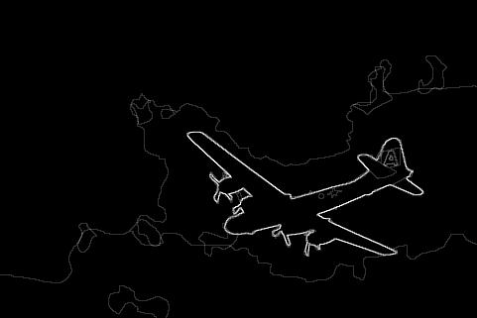
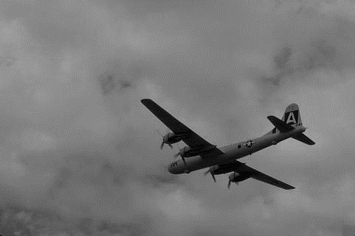
Motivation
Edges provide good amount of information to recognize an object
What is this object?

Slide 4
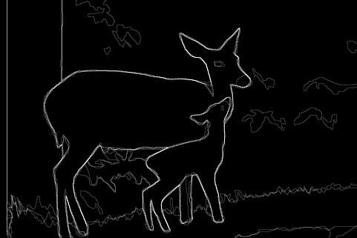
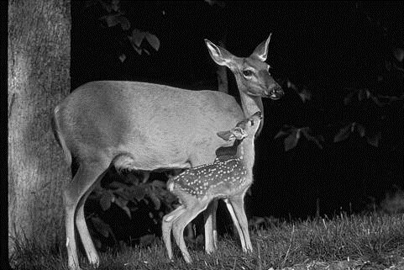
Motivation
What is this object?

Slide 5

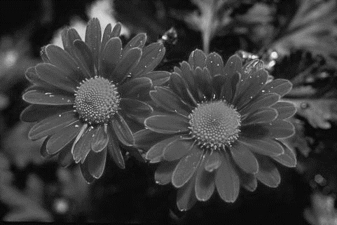
Motivation
What is this object?

Slide 6
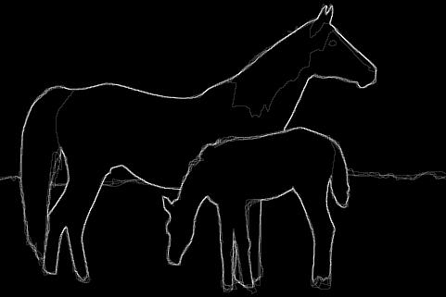
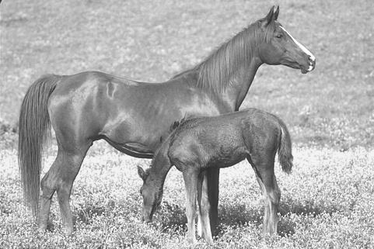
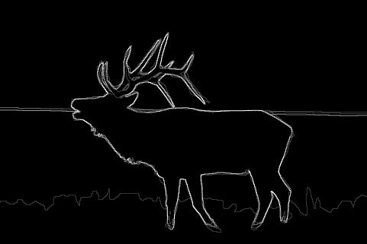
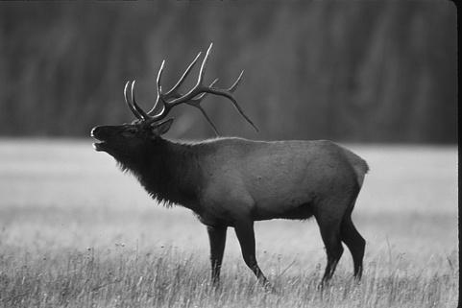
Motivation

Slide 7
Motivation
These highlighted pixels in the image are called edge pixels
Collectively these pixels define edges.

Slide 8
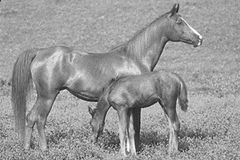
Why should we use Edges for Image Representation?
Edges provide good amount of information to recognize an object
Require less storage space
Edges are invariant (up to quite an extent) to image issues such as
Contrast
Illumination
Noise
etc.

Slide 9
What is an Edge in an image?
Edge is a boundary between two homogeneous regions
The gray level properties of the two regions on either side of an edge
are distinct, and
exhibit some local uniformity or homogeneity among themselves

Slide 10
What is an Edge in an image?
Examples of Ideal Edge (Step Edge)
Ideal Step edge in 1-D
Step edge in 2-D

Slide 11
Edge Detection
Goal: map image from 2D array of pixels to a set of curves or line segments or contours.
Main idea to detect edges
Look for pixels with strong gradient
Do some post-processing
An edge is typically extracted by computing the derivative of the image intensity function

Slide 12
Edge Detection
Edge detection - Computation of Image Gradient
Gradient is a directional quantity
Analysis of gradient consists of two parts:
–Magnitude of the gradient: measure of the strength /contrast of the edge
–Direction of the gradient vector: edge orientation

Slide 13
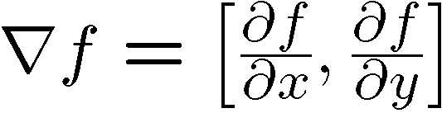







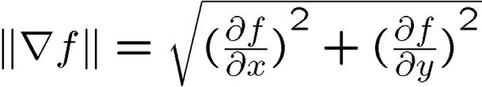
Edge Detection - Image Gradient
The gradient of an image:
The gradient points in the direction of most rapid change in intensity
The gradient direction (orientation of edge normal) is given by:
The edge strength is given by the gradient magnitude

Slide 14
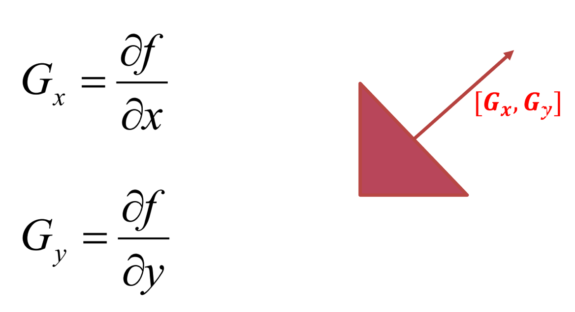
Edge Detection - Image Gradient
Direction of edge is always perpendicular to the direction of gradient [G_{x}, G_{y}]

Slide 15
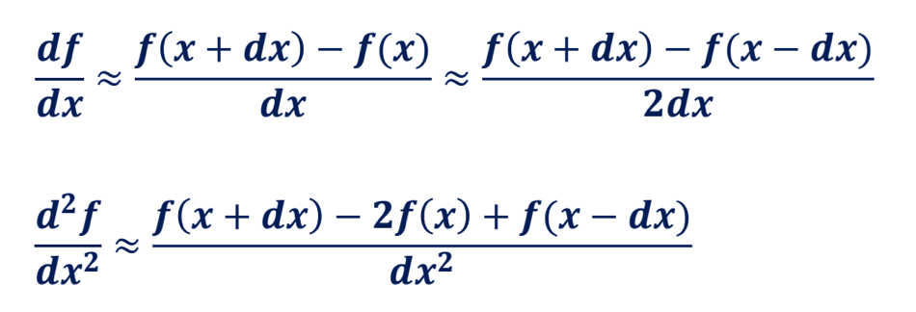
Edge Detection
Computing the derivatives:
Finite difference in 1-D
𝒇(𝒙)
(𝒙 − 𝒅𝒙)
𝒙
(𝒙 + 𝒅𝒙)
𝑿

Slide 16
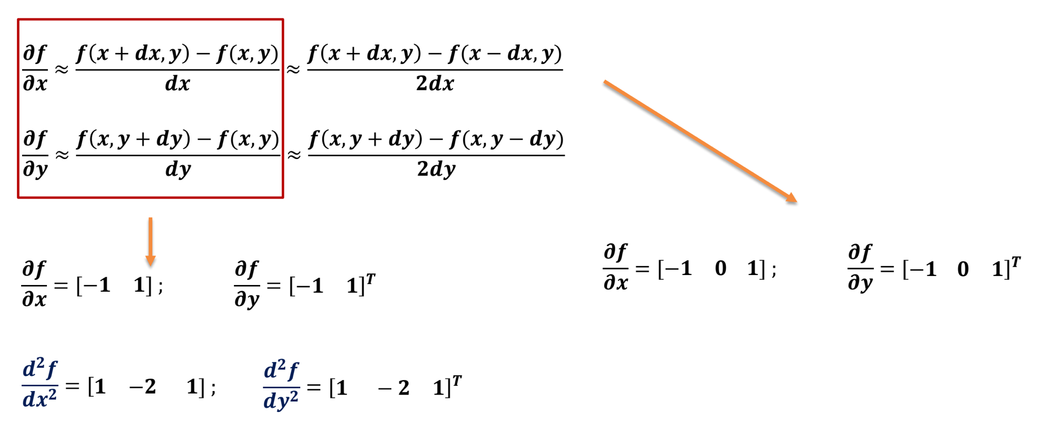
Edge Detection
Computing the derivatives:
Finite differences in 2-D

Slide 17
An ideal step edge and its derivative profile..
Intensity
Slice through image
Derivative

Slide 18
An ideal step edge and its derivative profile..
An ideal step edge and its first and second derivative profiles.
𝑭unction F(𝑰)
1st Derivative
2nd Derivative
Zero Crossing

Slide 19
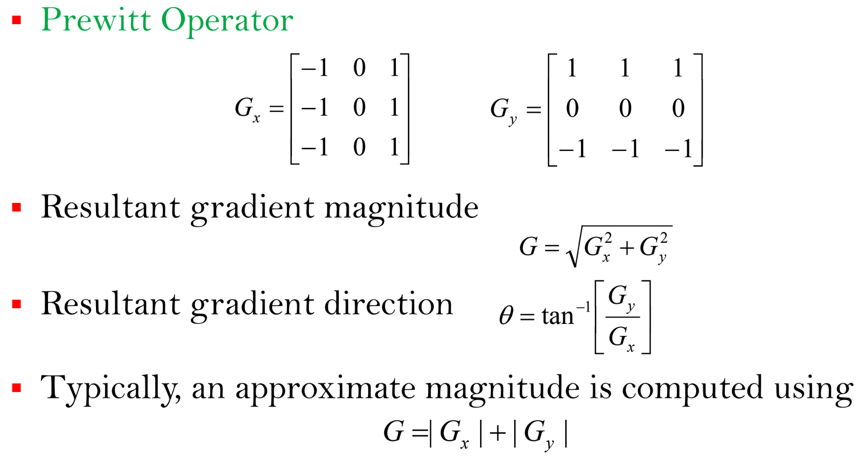
Important Edge Operators

Slide 20
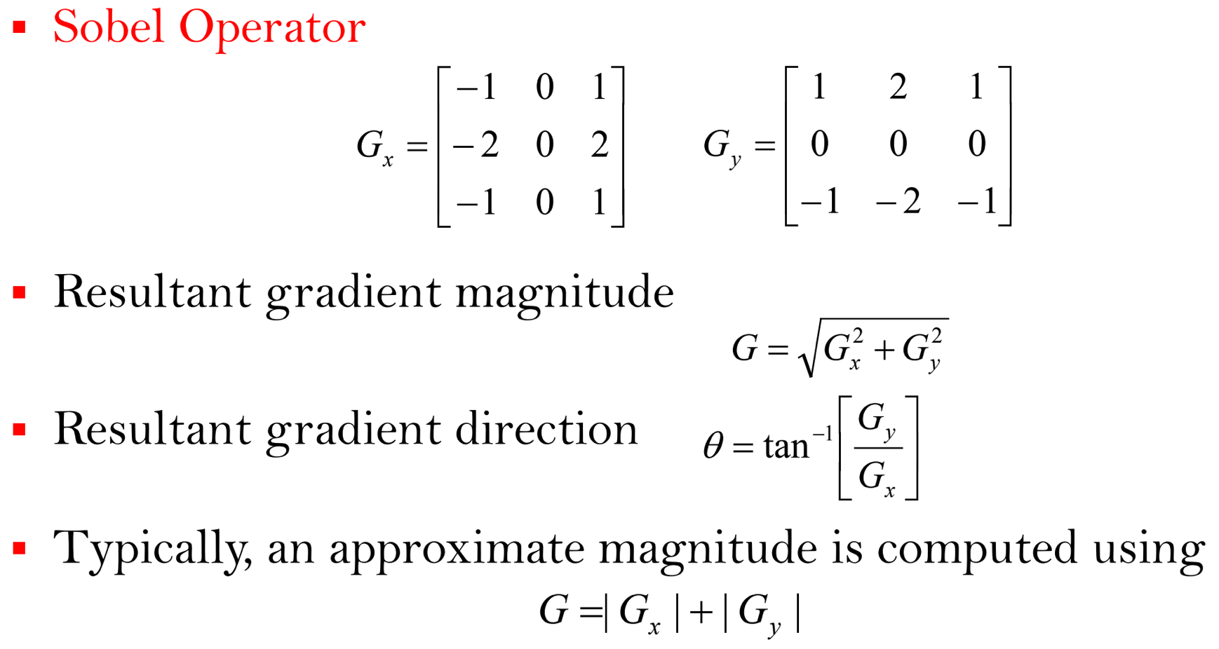
Important Edge Operators

Slide 21
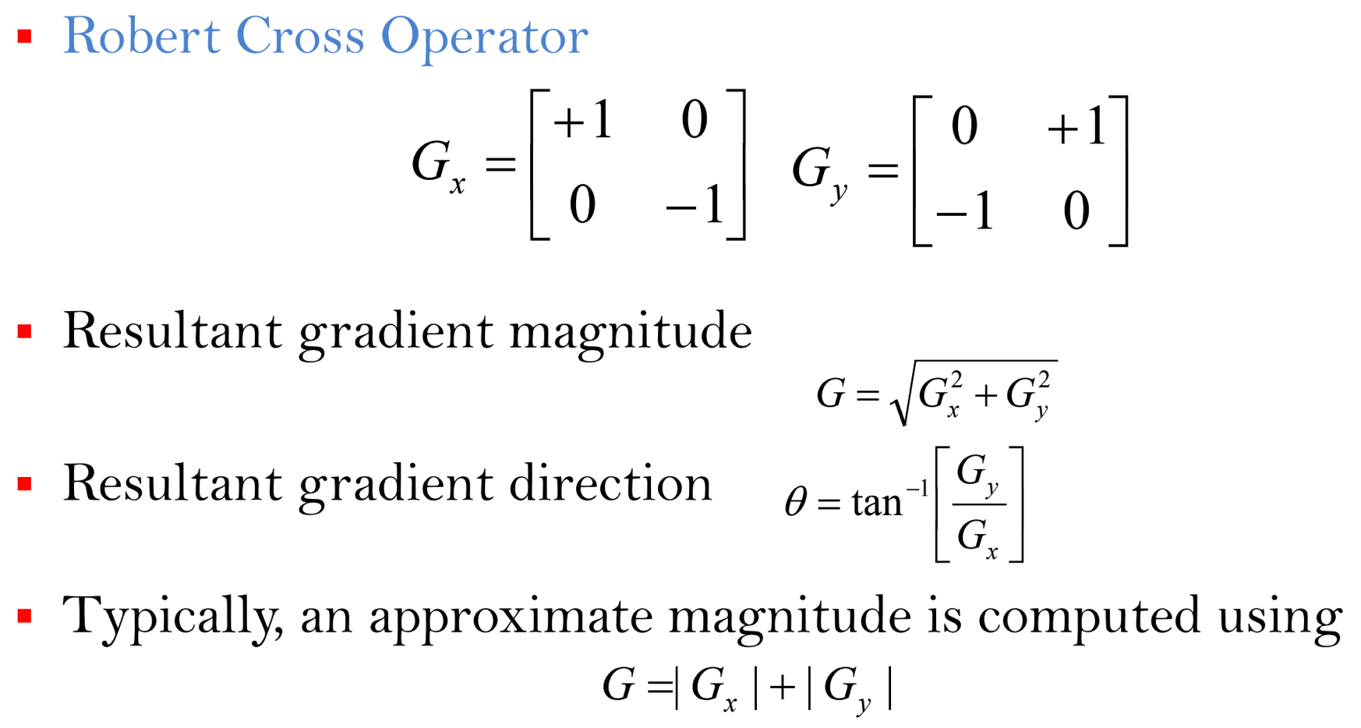
Important Edge Operators

Slide 22
End

Slide 23
Extraction of High Level Features from Images
Edge Detection
Part - 2

Slide 24

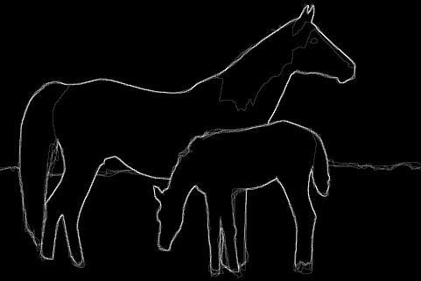
Quick recap: What is an edge?
Edges corresponds to significant local changes of intensity in a digital image.
An edge can be defined as a set of connected pixels that forms a boundary between two homogeneous regions.
Edge contains pixels of high gradient
Edge detection is computation of high gradient points in the image.
G_{x}
G_{y}
G_{x}
Gy

Slide 25
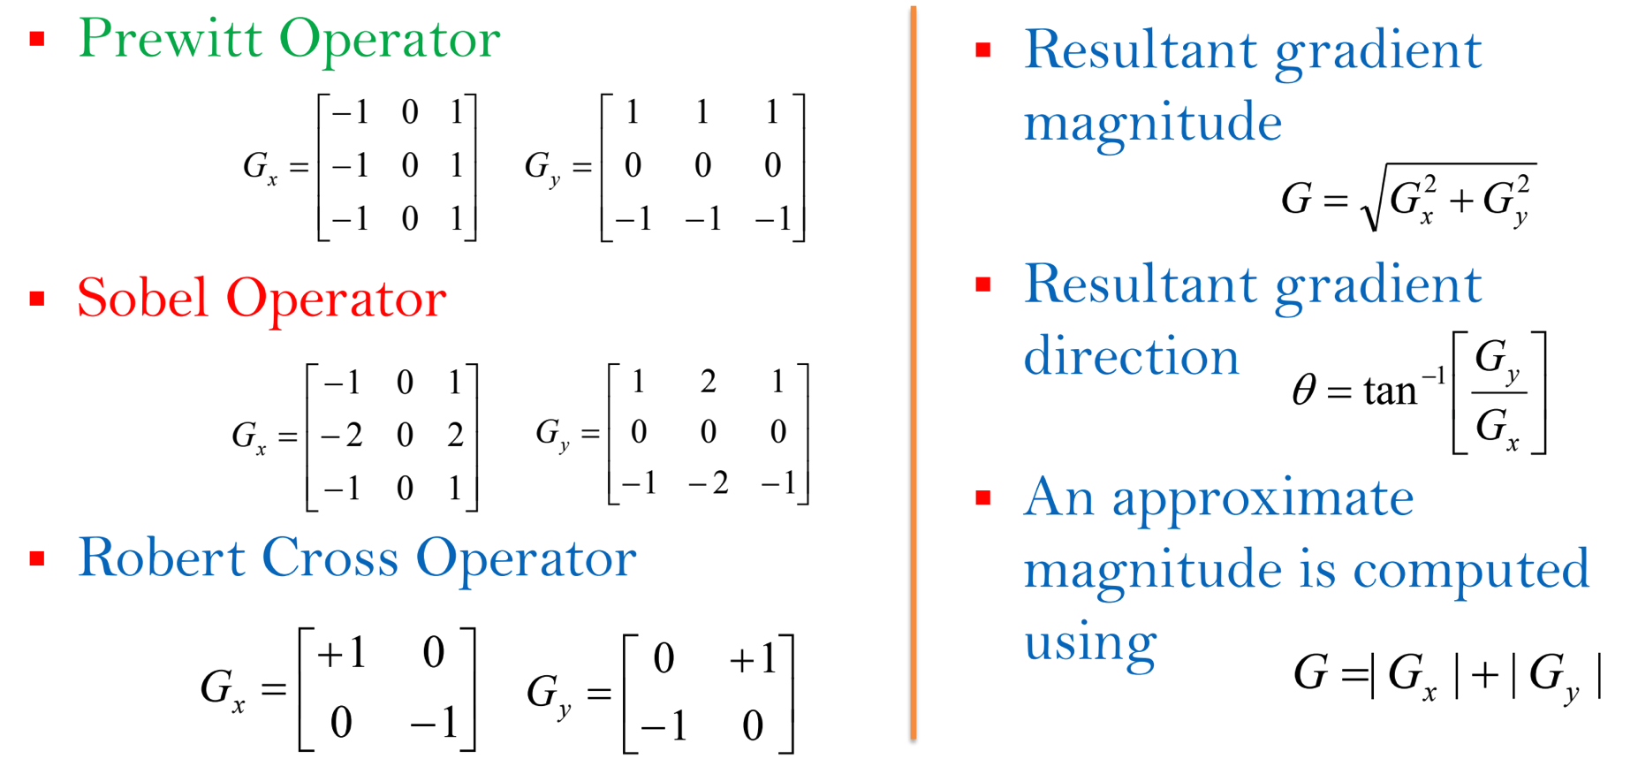
Quick recap: Important Edge Operators

Slide 26
Agenda for Today’s Class
Examples of edge detection based on gradient
1st order derivative
Edge detection using 2nd order derivative
Laplacian operator
Edge detection in noisy images
LoG Operator
DoG Operator

Slide 27
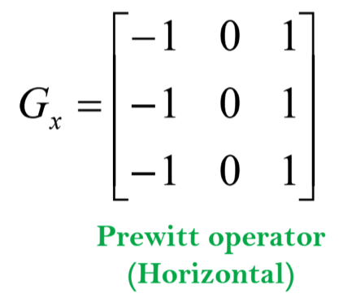

An example of edge detection: Prewitt Operator
9 | 9 | 9 | 0 | 0 | 0
9 | 9 | 9 | 0 | 0 | 0
9 | 9 | 9 | 0 | 0 | 0
9 | 9 | 9 | 0 | 0 | 0
9 | 9 | 9 | 0 | 0 | 0
9 | 9 | 9 | 0 | 0 | 0
 | 0 | -27 | -27 | 0
 | 0 | -27 | -27 | 0
 | 0 | -27 | -27 | 0
 | 0 | -27 | -27 | 0

Slide 28
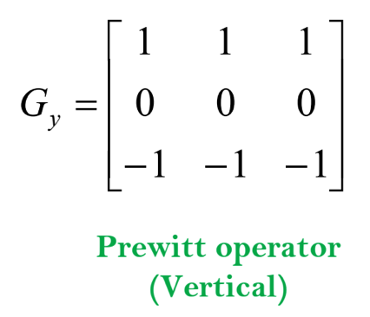
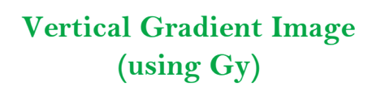
An example of edge detection: Prewitt Operator
9 | 9 | 9 | 0 | 0 | 0
9 | 9 | 9 | 0 | 0 | 0
9 | 9 | 9 | 0 | 0 | 0
9 | 9 | 9 | 0 | 0 | 0
9 | 9 | 9 | 0 | 0 | 0
9 | 9 | 9 | 0 | 0 | 0
 | 0 | 0 | 0 | 0
 | 0 | 0 | 0 | 0
 | 0 | 0 | 0 | 0
 | 0 | 0 | 0 | 0

Slide 29
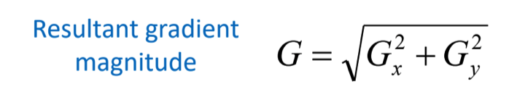

An example of edge detection: Prewitt Operator
 | 0 | -27 | -27 | 0
 | 0 | -27 | -27 | 0
 | 0 | -27 | -27 | 0
 | 0 | -27 | -27 | 0
 | 0 | 0 | 0 | 0
 | 0 | 0 | 0 | 0
 | 0 | 0 | 0 | 0
 | 0 | 0 | 0 | 0
 | 0 | 27 | 27 | 0
 | 0 | 27 | 27 | 0
 | 0 | 27 | 27 | 0
 | 0 | 27 | 27 | 0
Horizontal Gradient Image (using G_{x})
Vertical Gradient Image (using G_{y})
Resultant Gradient Image (using G)

Slide 30
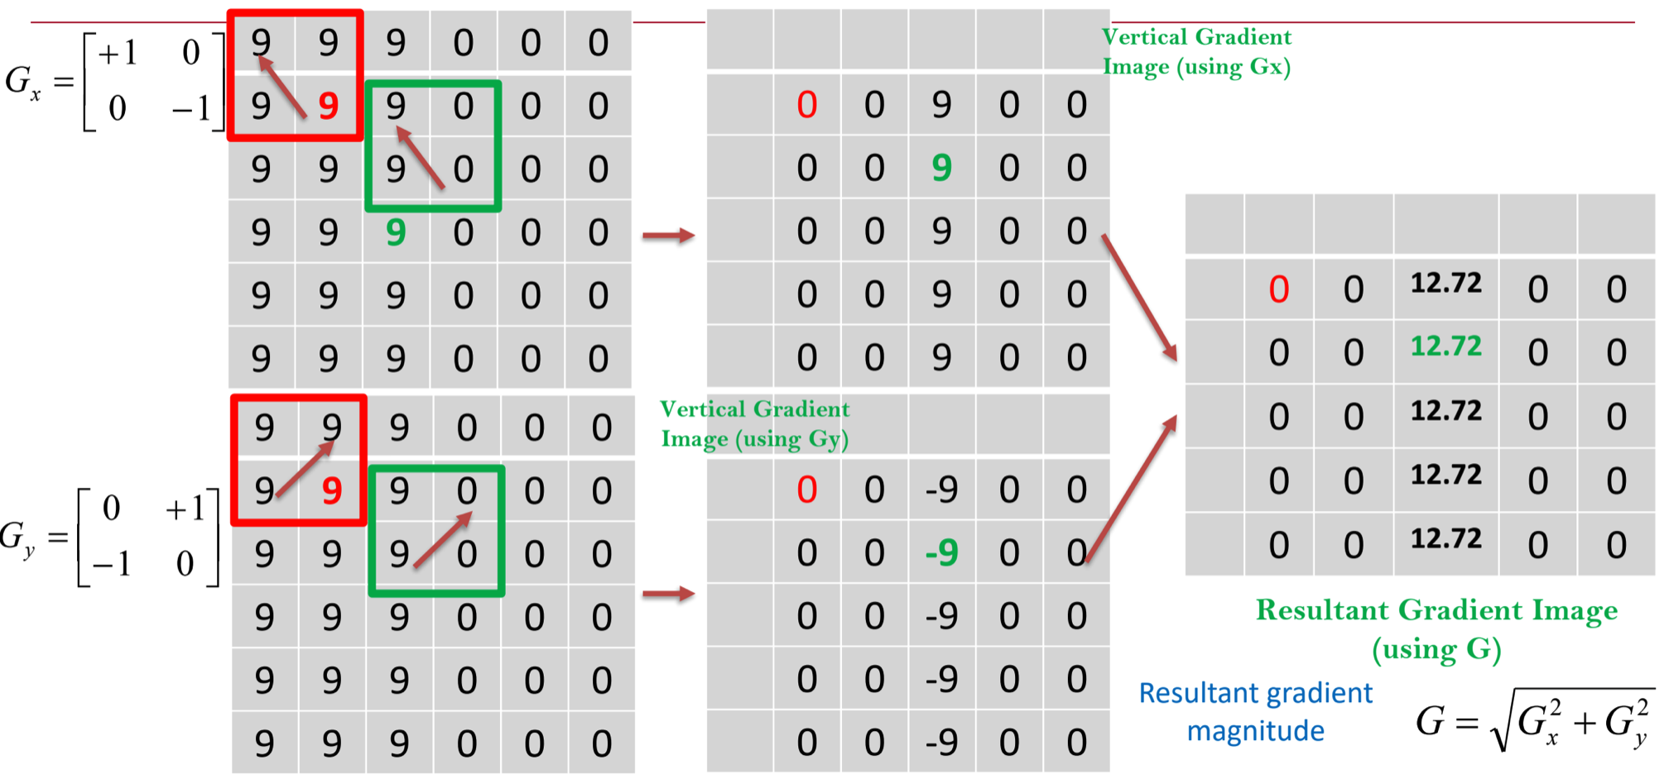
An example of edge detection: Robert Cross Operator

Slide 31
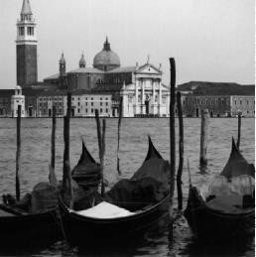
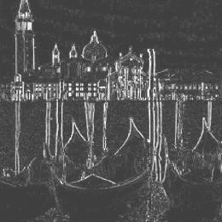
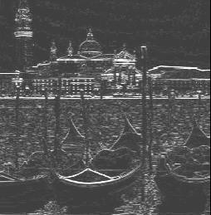
Examples: Edge Detection
Horizontal and vertical derivatives
Original Image
Horizontal
Gradient
Vertical
Gradient

Slide 32
Edge Detection – Thresholding
After computing the gradient, thresholding is need to be performed to get the edge location
Steps of thresholding
Choose a threshold value t
– Set any pixels less than t to zero
Set any pixels greater than or equal to t to one

Slide 33
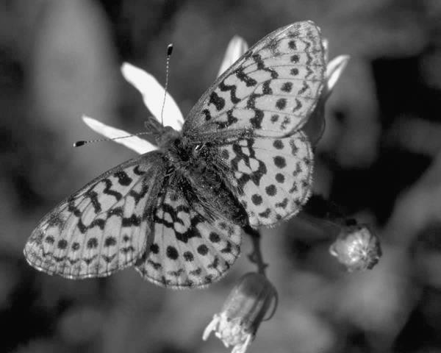
Original Image

Slide 34
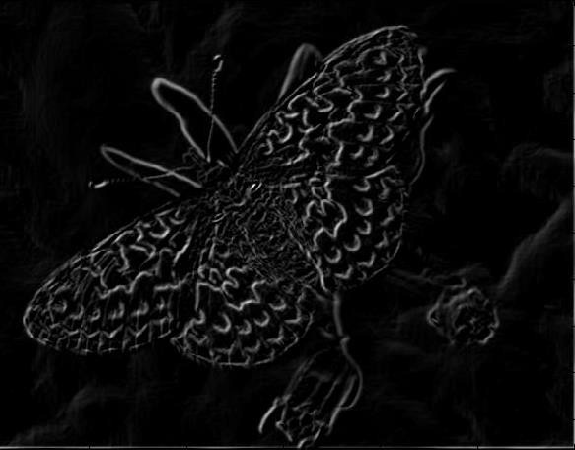
Gradient Magnitude Image

Slide 35
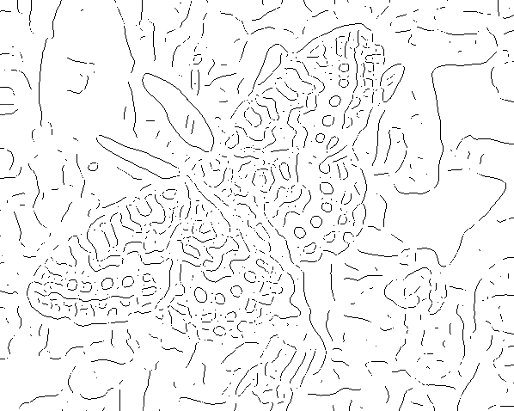
Thresholding gradient with a lower threshold

Slide 36
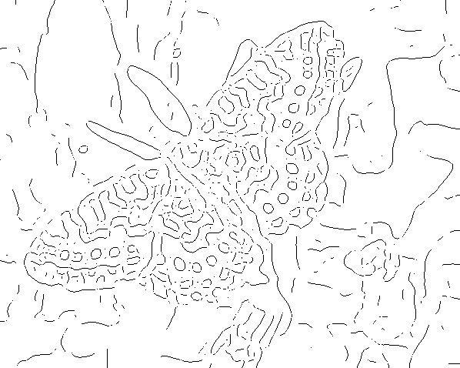
Thresholding gradient with a higher threshold

Slide 37
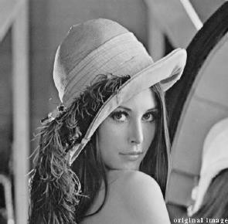
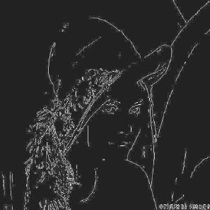
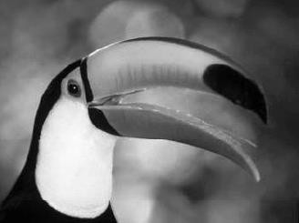
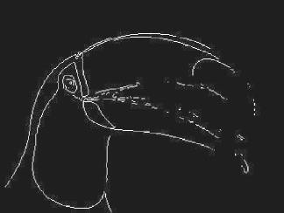
More results on Edge Detection
Original Image
Sobel Operator
Original Image
Sobel Operator

Slide 38
Edge Operator using 2nd Order Difference
When 2nd order difference is used in computing edges, edge location is computed by locating the
𝑭𝒖𝒏𝒄𝒕𝒊𝒐𝒏 𝑭(𝑰)
zero-crossings
𝟏𝒔𝒕 𝑫𝒆𝒓𝒊𝒗𝒂𝒕𝒊𝒗𝒆
𝟐𝒏𝒅 𝑫𝒆𝒓𝒊𝒗𝒂𝒕𝒊𝒗𝒆
𝒁𝒆𝒓𝒐 𝒄𝒓𝒐𝒔𝒔𝒊𝒏𝒈

Slide 39
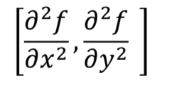
Edge Operator using 2nd Order Difference
Second derivative in x- and in y-direction
∇² is the Laplacian operator:
𝜕²𝑓
𝜕²𝑓
𝛻²𝑓 =
+
𝜕𝑥²
𝜕𝑦²
For an image, f(x, y)
𝜕²𝑓(𝑥, 𝑦)
𝜕²𝑓(𝑥, 𝑦)
𝐿 𝑥, 𝑦 = 𝛻²𝑓 𝑥, 𝑦 =
+
𝜕𝑥²
𝜕𝑦²

Slide 40
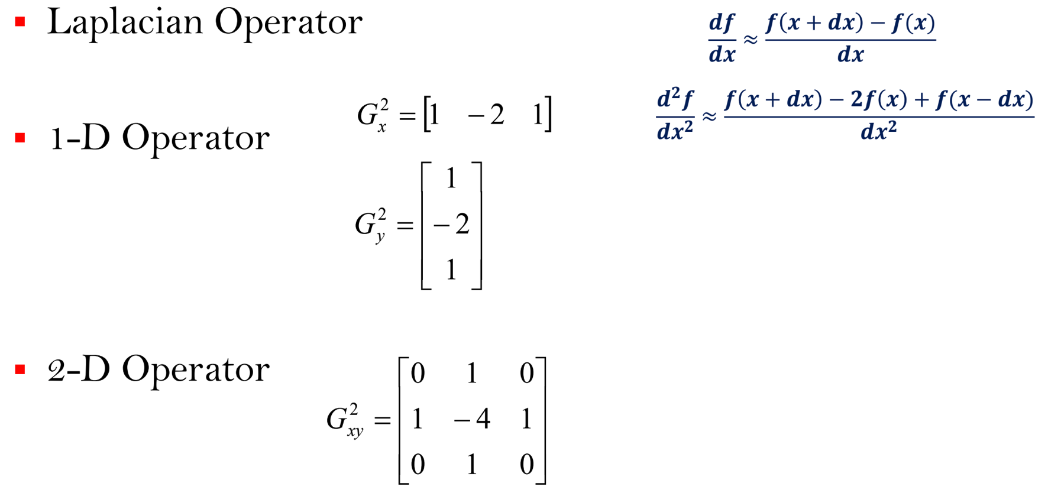
Edge Operator using 2nd Order Difference

Slide 41
Edge Operator using 2nd Order Difference
Edge Detection using Laplacian Operator
–Filter the image using Laplacian filter
–Look for zero-crossings in the filtered image

Slide 42
Problems with these Edge Detection Methods
Input Image
Edge Detection
Edge Map
Most of these partial derivative operators are sensitive to noise
Use of these masks
result in thick edges or boundaries
Give spurious edge pixels due to noise
Particularly, Laplacian mask is highly sensitive to spike noise

Slide 43
Edge Detection in Noisy Images
To overcome the effect of noise, we perform smoothing operation before edge detection
Smoothing operation
Input Image
Edge Detection
Edge Map
However, it should be noted that noise smoothing, typically by the use of a Gaussian function, causes blurring or smearing of the edge information or
gradient values

Slide 44
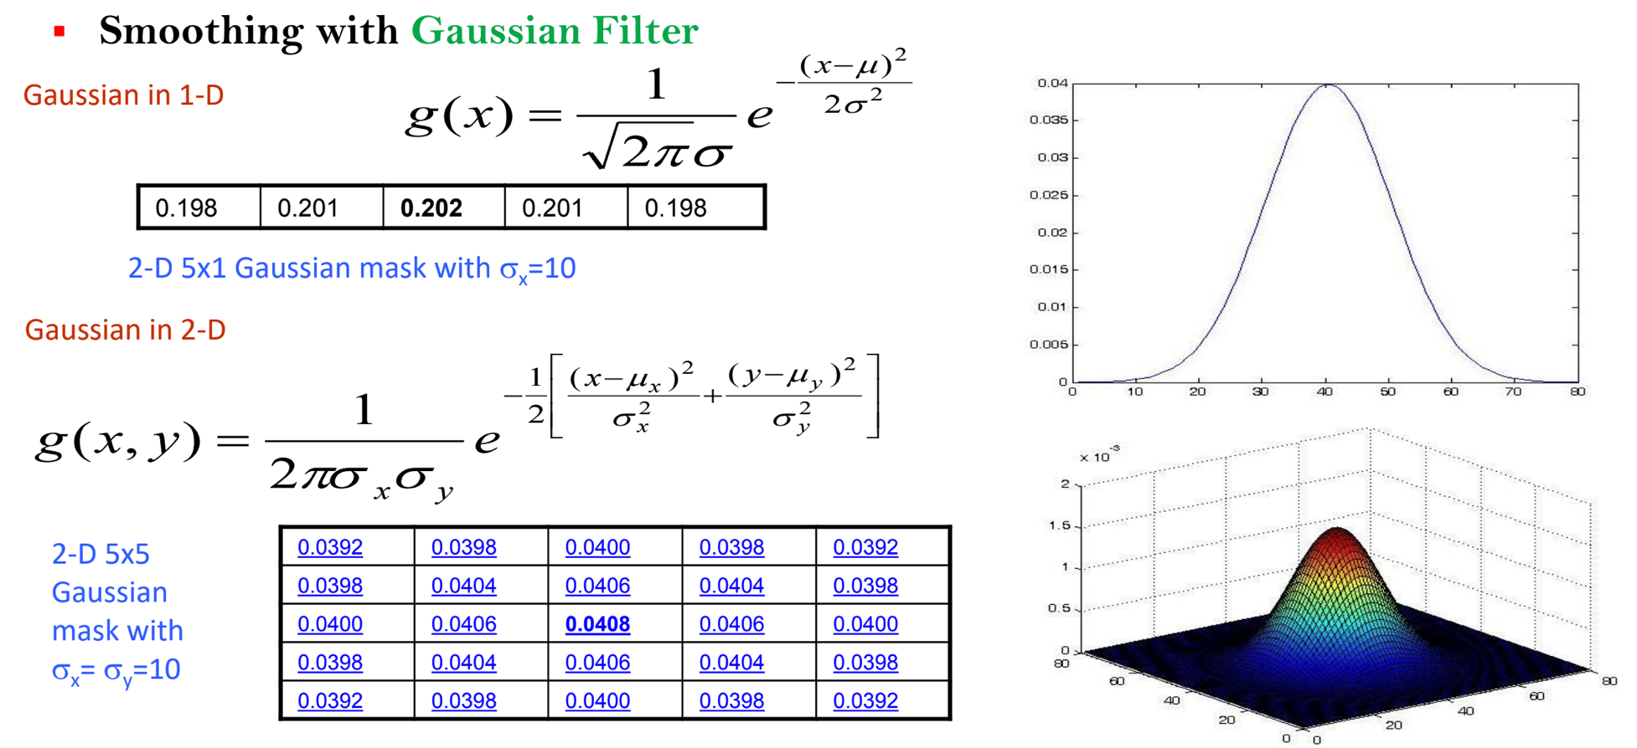
Edge Detection in Noisy Images

Slide 45
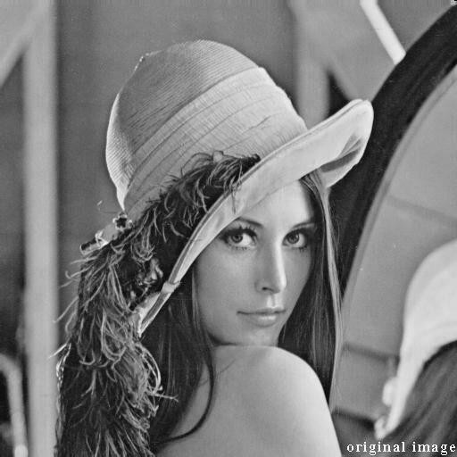
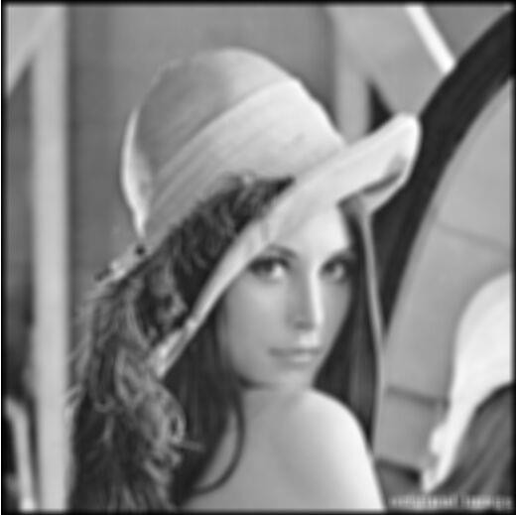
Edge Detection in Noisy Images
Smoothing with Gaussian Filter
Mask size = 9x9, sigma=5

Slide 46
Edge Detection in Noisy Images
Edge Detection Steps (to handle noise):
Smoothing:
Suppress noise using filters such as Gaussian filter
Edge Localization
Determine which local maxima from filter output are actually edges
Threshold followed by
Thinning
Gradients
Edges

Slide 47
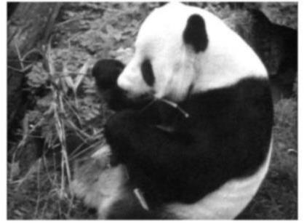
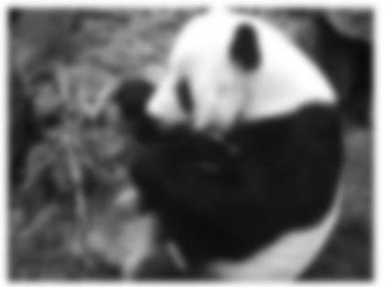
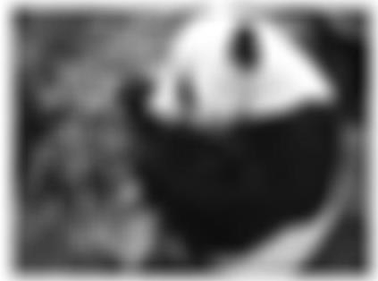
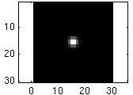
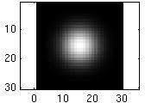
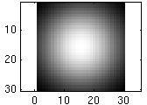
Effect of σ on Gaussian smoothing
Parameter σ is the “scale” / “width” / “spread” of the
Gaussian kernel, and controls the amount of smoothing
…

Slide 48
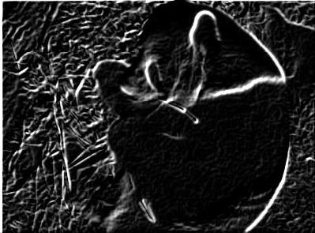
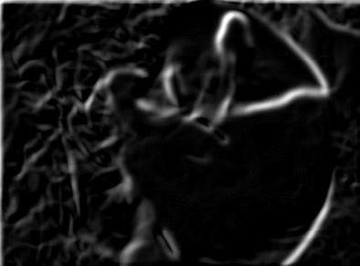
Effect of σ on Derivatives
^{σ = 1 pixel} σ = 3 pixels
The apparent structures differ depending on Gaussian’s scale parameter.
🡺 Larger values: larger scale edges detected
🡺 Smaller values: finer features detected

Slide 49
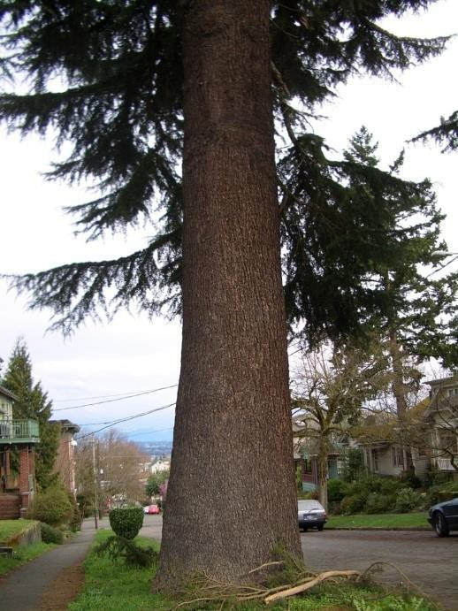

So, what scale to choose?
It depends on what we are looking for
Often, we may want to analyze at multiple scales

Slide 50
Edge Detection in Noisy Images
Two popular operators:
–LoG Operator
–DoG Operator
….to continue in the next class

Slide 51
End

Slide 52
Extraction of High Level Features from Images
Edge Detection
Part - 3

Slide 53
Quick Recap of the Last Class
Edge Detection in Noisy Images
To overcome the effect of noise, we perform smoothing operation before edge detection
Smoothing operation
Input Image
Edge Detection
Edge Map
However, it should be noted that noise smoothing, typically by the use of a Gaussian function, causes blurring or smearing of the edge information or gradient values

Slide 54
Agenda
Edge detection in noisy images
How to reduce blurring introduced during noise removal in edge detection?
Blurring is an opposite operation to edge detection
Solution:
Do not apply smoothing and edge detection separately
Combine smoothing and edge detection
Operators which combine smoothing and edge detection
LoG Operator
DoG Operator
Canny edge detector

Slide 55
Edge Detection Operators
Laplacian of Gaussian function (LOG)
Also called Marr-Hildreth operator
Involves two operations
Smoothing (for noise removal)
Filtering using Laplacian operator (for edge detection)
LOG filter combines these two operations
DOG operator
Canny edge detector
based on Smoothing

Slide 56
Laplacian of Gaussian (LOG) Operator
Laplacian mask
Since is highly sensitive to spike noise, Marr and Hildreth (1980) suggested the use of the “Laplacian of Gaussian” (LOG) operator to detect edges in presence of noise
This produces edges as Zero-Crossings in the output function

Slide 57
Laplacian of Gaussian (LOG) Operator
Limitations of LOG Operator:
LOG does not give any idea of the
gradient magnitude and
orientation of the edges
▪
How was gradient magnitude helping?
– Tells the strength of the edge

Slide 58

LOG Operator: Use of 2nd order derivative of Gaussian

Slide 59

Derivatives of Gaussian

Slide 60

Derivatives of Gaussian
First derivative of Gaussian
Gaussian in 1-D
G(x)
x
Second derivative of Gaussian (LOG operator in 1-D)

Slide 61



LoG Operator in 2D
Gaussian in 2-D
Laplacian of Gaussian in 2-D

Slide 62

Laplacian of Gaussian (LoG) in 2-D
This 2-D LoG can be approximated by a 5 by 5 convolution kernel such as
The kernel of any other sizes can be obtained by approximating the continuous expression of LoG given above.
However, make sure that the sum (or average) of all elements of the kernel has to be zero (similar to the Laplace kernel) so that the convolution result of a homogeneous regions is always zero.

Slide 63






Response of LoG on Step Edge
Consider
Laplacian of Gaussian operator
h
Where is the edge?
Look for Zero-crossings in bottom graph

Slide 64

Response of LoG on Step Edge
The LoG operator calculates of the image.
second spatial derivative
This means that
LoG response will be zero in areas where the image has a constant intensity (i.e. where the intensity gradient is zero),
In the vicinity of a change in intensity, the LoG response will be
positive on the darker side, and
negative on the lighter side

Slide 65
Response of LOG on Step Edge
In summary
at a reasonably sharp edge between two regions of uniform but different intensities, the LoG response will be:
zero at a long distance from the edge
positive just to one side of the edge
negative just to the other side of the edge
zero at some point in between, on the edge itself

Slide 66
Finding Zero crossings
Four cases of Zero-crossing
– {+,-}
– {+,0,-}
– {-,+}
– {-,0,+}
Slope of zero-crossing {a,-b} is
|a + b|
To detect edge
Compute slope of zero-crossings
Apply a threshold on the slope
Idea behind detection of zero-crossings was that we just need to detect zeros (no threshold required) which is easy as compared to thresholding where we need to find a threshold
However, it turns out that to avoid weak edges, we need to put some threshold on slope of the zero-crossings

Slide 67


DoG Operator:
Fast approximation of LoG by Difference of Gaussians
LoG in 1-D
DoG in 1-D
Convolve the image with two Gaussian of different sigma, and
Take the difference to get the edge map

Slide 68
End

Slide 69
Edge Detection
Extraction of High Level Features from Images
Part - 4
Canny Edge Detection

Slide 70
Recap of what we discussed on Edge Detection
Operators based on 1st order derivatives
Operators based on 2nd order derivative
Edge detection in noisy images
LoG Operator
DoG Operator

Slide 71

Quick Recap: Operators based on 1st Order Differences
We look for high gradient points to detect edge in these operators

Slide 72

Quick Recap: Operators Based on 2nd Order Differences
Laplacian operator
Detection of zero-crossings in the second order differences captures local maxima in the gradient
Edge detection is carried out by locating these zero-crossings

Slide 73
Quick Recap: Edge Detection in Noisy Images
To overcome the effect of noise, we perform smoothing operation before edge detection
Input Image
Smoothing operation
Edge Detection
Edge Map
However, it should be noted that noise smoothing, typically by the use of a Gaussian function, causes blurring or smearing of the edge information or gradient values

Slide 74



Quick Recap: Edge Detection in Noisy Images
Laplacian of Gaussian function (LoG)
Also called Marr-Hildreth operator
Two Operations
Smoothing
Applying Laplacian operator
Or generate the combined mask of LoG
DoG Operator

Slide 75
Agenda for Today’s Class
Edge detection in noisy images
– Canny edge detection

Slide 76




Normally, edge operators use one threshold for whole image
Sobel output
Sobel output

Slide 77
Canny Edge Detection
Canny in 1986 suggested an optimal operator, which uses the Gaussian smoothing and the derivative function together
He proved that the first derivative of the Gaussian function, is a good approximation to his optimal operator
It combines both the derivative and smoothing properties in a nice way to obtain good edges
Canny also talks of a hysteresis based thresholding strategy for marking the edges from the gradient values (use of two thresholds)

Slide 78
Canny Edge Detector
It is an optimal edge detector
An "optimal" edge detector means:
Good detection - the algorithm should mark as many real edges in the image as possible.
Good localization - edges marked should be as close as possible to the edge in the real image.

Slide 79

Canny Edge Detection
Canny’s algorithm for edge detection:
Detect an edge, where simultaneously the following conditions are satisfied:
∇²G*f = 0 and
∇G*f reaches a maximum

Slide 80
Canny Edge Detector
Canny edge detector detects
–weak edges, as well as
–strong edges
Uses two threshold values to detect weak and strong edges

Slide 81
Steps in Canny Edge Detector
Stages of the Canny algorithm
–Noise reduction: raw image is convolved with a Gaussian filter
–Finding the intensity gradient of the image
–Non-maximum suppression
–Tracing edges through the image and hysteresis
thresholding

Slide 82
Stages of the Canny algorithm
Step 1: Noise reduction
raw image is convolved with a Gaussian filter
Step 2: Finding the intensity gradient of the image
Intensity gradient is estimated from the smoothed image using simple horizontal and vertical difference operators
Gradient direction together with the gradient magnitude then gives an estimated intensity gradient at each point in the image
Canny algorithm uses both gradient magnitude and direction in the edge detection

Slide 83
Stages of the Canny algorithm
Notes:
–Smoothing and derivative applied separately:
when applied separately, it does not produce good results under noisy conditions. This is because, one opposes the other.
–Smoothing and derivative applied together:
when combined together, it produces the desired output

Slide 84
Stages of the Canny algorithm
Step 3: Non-maximum suppression: After the estimation of the image gradients
A search is carried out to determine if the gradient magnitude assumes a local maximum in the gradient direction
From this stage, referred to as non-maximum suppression, a set of edge points in the form of a binary image are obtained
Output of this stage is sometimes referred to as thin edges

Slide 85
Stages of the Canny algorithm
Step 4: Hysteresis
Tracing edges through the hysteresis thresholding
If only one threshold is used
Large threshold: gives true edges
Small threshold: gives false edges
Canny algorithm does not use same threshold for whole image
It does thresholding with hysteresis

Slide 86
Stages of the Canny algorithm
Thresholding with hysteresis requires two thresholds - high and low
Use the high threshold to start edge curves and the low threshold to continue them
We begin by applying a high threshold
– This marks out the edges we can be fairly sure are genuine
Starting from these strong edge points, using the directional information derived earlier, edges can be traced through the image
While tracing an edge, we apply the lower threshold, allowing us to trace faint sections of edges as long as we find a starting point

Slide 87

Stages of the Canny algorithm
Original image
Smoothing by Gaussian convolution
Differential operators along x and y axis
Non-maximum suppression
finds peaks in the image gradient
Hysteresis thresholding locates edge strings Edge map

Slide 88

The Canny edge detector
Original image (Lena)

Slide 89

The Canny edge detector
Magnitude of the gradient

Slide 90

The Canny edge detector
Thresholding

Slide 91



The Canny edge detector
How to turn these thick regions of the gradient into curves?
Thresholding

Slide 92

The Canny edge detector
Problem: pixels along this edge didn’t survive the thresholding
Normal thresholding-issues

Slide 93


Canny Edge Detection
Non-maximum suppression:
– Select the single maximum point across the width of an edge.

Slide 94


Non-maximum Suppression
Check if pixel is local maximum along gradient direction, select single max across width of the edge
– requires checking interpolated pixels p and r

Slide 95

Canny Edge Detection
Non-maximum suppression
At q, the value must be larger than values interpolated at p or r.
p
q
Gradient
r

Slide 96



Examples: Non-Maximum Suppression
Original image
Gradient magnitude
Non-maxima suppressed
Image courtesy of G. Loy

Slide 97
🡺 Use of one threshold
🡺 Smoothing used to remove noise; it also impacts weak edges

Slide 98

🡺 Use of one threshold
🡺 Smoothing used to remove noise; it also impacts weak edges
fine scale (σ = 1)
high threshold

Slide 99
🡺 Use of one threshold
🡺 Smoothing used to remove noise; it also impacts weak edges
coarse scale, (σ = 4)
high threshold

Slide 100
🡺 Use of one threshold
🡺 Smoothing used to remove noise; it also impacts weak edges
coarse scale (σ = 4)
low threshold

Slide 101
Hysteresis Thresholding
Check that maximum value of gradient is sufficiently large
drop-outs? use hysteresis
use a high threshold to start edge curves and a low threshold to continue them.

Slide 102
Edge Hysteresis
Idea: Maintain two thresholds k_{high} and k_{low}
–Use k_{high} to find strong edges to start edge chain
–Use k_{low} to find weak edges which continue edge chain
Typical ratio of thresholds is roughly
^{k}high ^{/ k}low ⁼ ²

Slide 103




Hysteresis Thresholding
original image
high threshold (strong edges)
low threshold (weak edges)
hysteresis threshold

Slide 104



Example: Canny Edge Detection
gap has been filled
Original image
Strong + connected weak edges
Strong edges only
Weak edges
courtesy of G. Loy

Slide 105


Edge Detection – Comparison Examples
Original Image
Sobel
Canny
LoG

Slide 106


Original
Image
Sobel
Canny
LoG

Slide 107



Canny Edge Detection: Effect of Threshold
σ = 1
T_{high} = 255 T_{low} = 1
σ = 1
T_{high} = 255 T_{low} = 220

Slide 108


Canny Edge Detection: Gaussian kernel size
σ = 1
T_{high} = 120 T_{low} = 1
σ = 2
T_{high} = 120 T_{low} = 1

Slide 109




Object boundaries vs. edges: Edge detection is just the beginning…
Image Object segmentation

Slide 110
Canny Operator In MATLAB
In MATLAB:
>> edge(image, ‘canny’);
>> help edge

Slide 111
End

